Slide 1
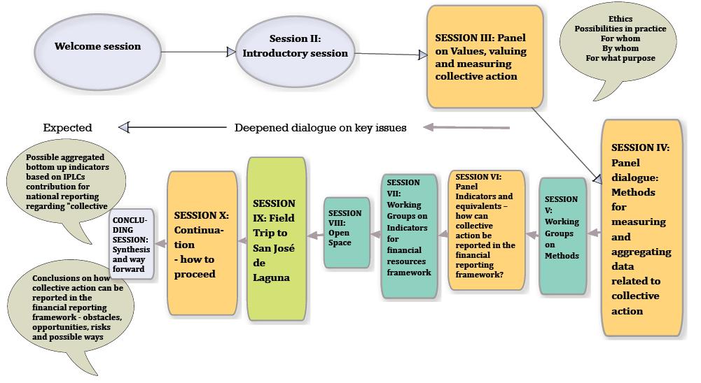
Dialogue Workshop on Assessment of Collective Action of Indigenous Peoples and Local Communities in Biodiversity Conservation and Resource Mobilization
11-13 June 2015, Panajachel, Guatemala

Slide 2
The dialogues starts with dialogues already in the planning phase, to develop the agenda we have
The facilitated dialogue:
assumption that many people have pieces of the answer and that together they can craft a suite of solutions.
active listening is encouraged with the intention to understand each other's viewpoints, find meaning and agreement.
Three features differentiate a dialogue from a discussion:
Equality
Listening with empathy
Bringing assumptions into the open.
“The magic of dialogue; transforming conflict into cooperation”, Yankelovich, D, New York, 1999”
Notes:
MS:
The mulit actor dialogue we work with start day one in the planning of a dialogue, we have evaluated Quito I and we have had face to face meetings and skype meetings etc with participants and relevant actors, and this has resulted in the dialogue agend we have in front of us now.
In the facilitated dialogues that we are trying to perform there is an assumption that many people have pieces of the answer and that together they can craft a suite of solutions. It's an approach where active listening is encouraged with the intention to understand each other's viewpoints, find meaning and agreement.
Three distinctive features could differentiate a dialogue from a discussion, when all three are present a conversation is transformed into a dialogue:
- Equality and the absence of coercive influences
- Listening with empathy
- Bringing assumptions into the open.
“The magic of dialogue; transforming conflict into cooperation”, Yankelovich, D, New York, 1999.

Slide 3
Possible forms/House rules for the seminar?
Chatham House rule - participants are free to use the information received, but neither the identity nor the affiliation of participantsexpressing a view may be revealed.
In SwedBio seminars that implies that presentations would be public, but not what the presenters express themselves in discussions. The rule allows people to speak as individuals and to express views that may not be those of their organisations, and therefore encourages free discussion. Speakers are free to voice their own opinions, without concern for their personal reputation or their official duties and affiliation.
Additional rules for the seminar/s includes the following principles, based on respect:
to listen actively, e.g. ’follow flow and focus’ not to use telephone, sms or email in the meeting room
to contribute to trust
to show respect for others, e.g. to attack issues, not persons
to ask for the turn to speak
to respect time, both as panellist and as participant
and to give the facilitator permission to run the seminar according to her/his plan throughout each session.
Notes:
The seminar was based on the Chatham House rule. This means that participants are
free to use the information received, but neither the identity nor the affiliation of par ticipants
expressing a view may be revealed. For the speakers it was agreed that their
presentations would be public, but not what they expressed in discussions. The rule allows
people to speak as individuals and to express views that may not be those of their
organisations, and therefore encourages free discussion. Speakers are free to voice their
own opinions, without concern for their personal reputation or their official duties and
affiliation.5
Additional rules for the dialogue included the following principles, based on respect: to listen actively, e.g. ’follow
flow and focus’; not to use telephone, sms or email in the meeting room; to contribute to trust; to show respect for
others, e.g. to attack issues, not persons; to ask for the turn to speak; to respect time, both as panellist and as participant;
and to give the facilitator permission to run the seminar according to her plan throughout each session.

